Slide 1

Wilson Financial Case Study
Jason Schriner, Mark White, Rachel Shaw, Rachel Theis

Slide 2
Group 2
Our group consisted of Rachel Theis, Mark White, Rachel Shaw, and Jason Schriner. To facilitate efficient communication and ensure quick progress, we primarily used Discord as our platform for collaboration. Rather than breaking the project into separate tasks and assigning each person a specific piece, we chose to work collectively. Each member contributed actively by regularly posting new sections of the project or refining existing components. This approach allowed us to remain flexible, leverage everyone's strengths, and maintain continuous momentum throughout the project.

Slide 3

Case Study: Wilson Financial
Owners:
Jake & Ned Wilson
Services:
Financial Management
Financial Advisory
Location:
Rural New Mexico
Case Study Objective:
Analyze Billing Structure

Slide 4
Problems a Database could help Wilson Financial address
Do they need to change the billing structure?
Are they acquiring clients quickly enough?
Do they have any clients who regularly use their services and represent a higher value to the business?

Slide 5
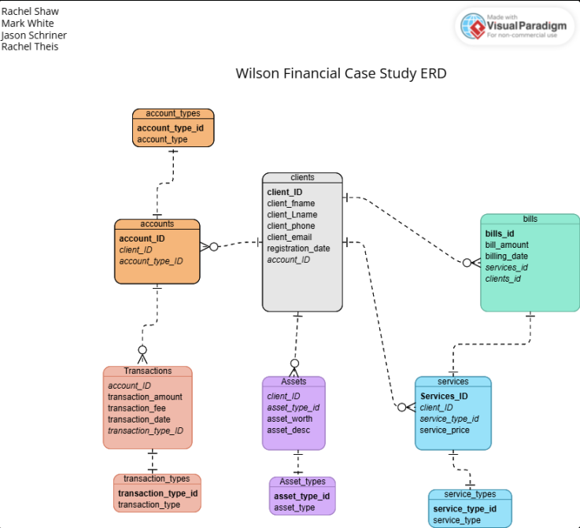
Entity Relationship Diagram (ERD) for establishing the database design

Slide 6
Reports the Database could help generate
How many clients have been added in the last month?
What is the average amount of assets (in currency) for the entire client list?
How many clients have a high number (more than 10 a month) of transactions?
How many bills have been sent within the past 6 months?

Slide 7
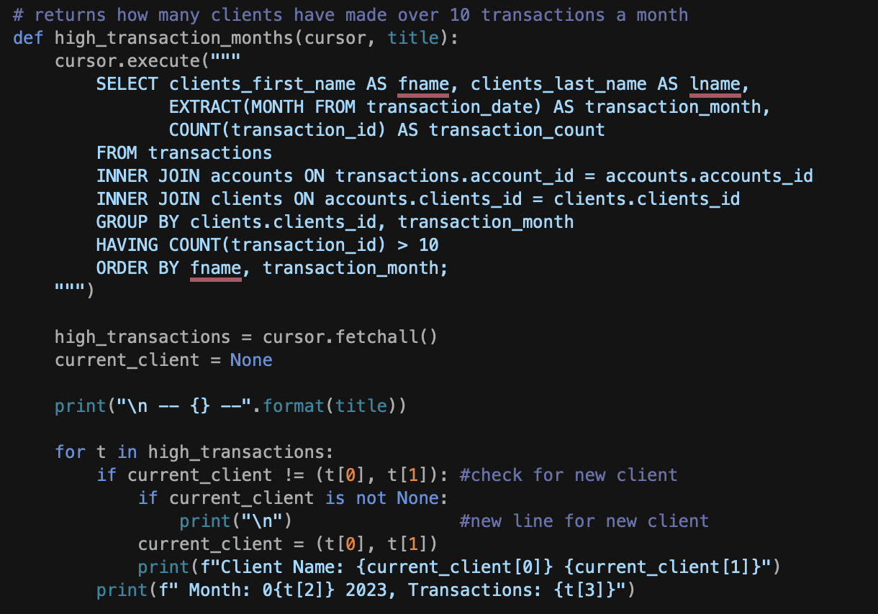

How many clients have been added in the last month?
Code
Output
By generating this code it is possible to query the database to establish how many new clients they acquired in the past 6 months to determine if more advertising was needed.

Slide 8
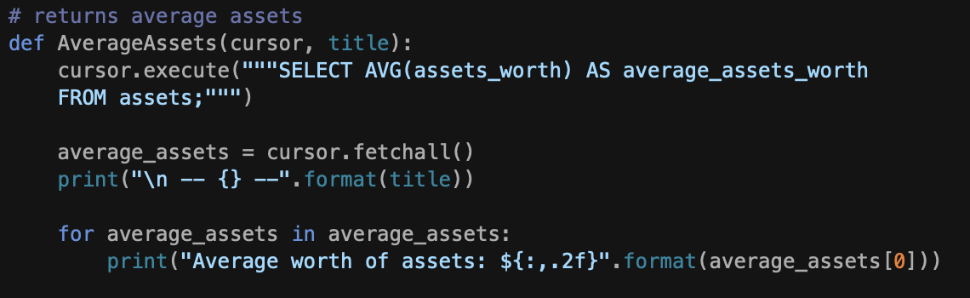

What is the average amount of assets (in currency) for the entire client list?
Code
Output
This query would help Wilson Financial determine what is the best services to offer their clients and what their clients might be able to afford.

Slide 9
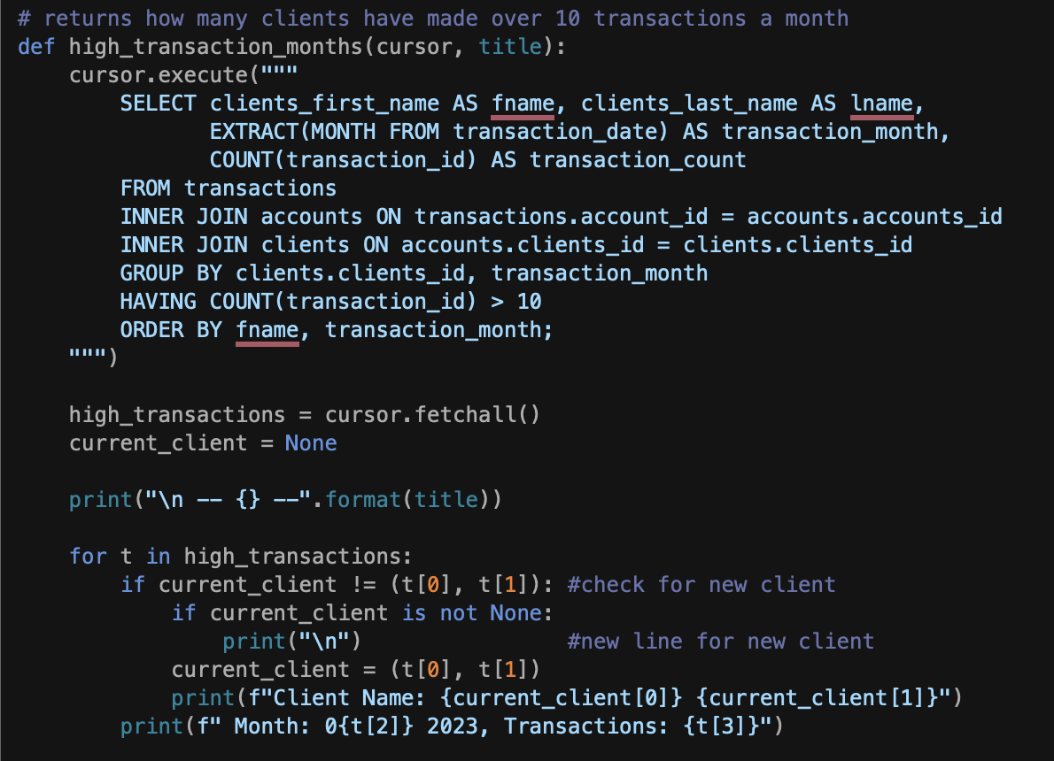
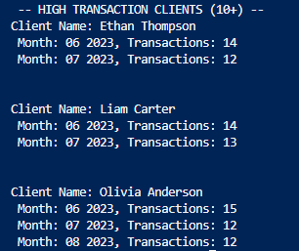
How many clients have a high number (more than 10 a month) of transactions?
Code
Output

Slide 10

Continued
This records search allows Wilson Financial to determine who if anyone regularly uses their services. This can guide decisions like adding offerings for frequent users.

Slide 11
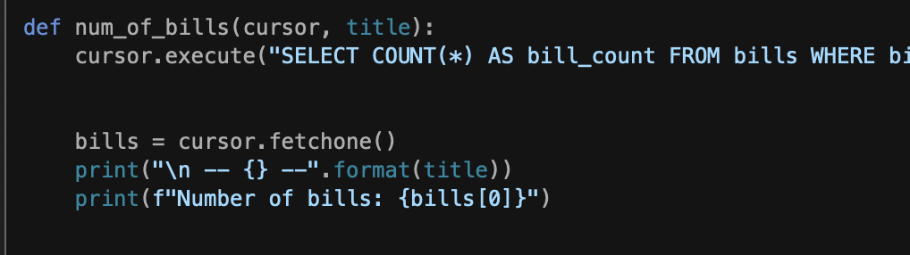

How many bills have been sent within the past 6 months?
Code
Output
This database query will help to determine if they are generating enough revenue and have enough clients to stay profitable.

Slide 12

Conclusion
The addition of a database to the Wilson Financial business enables Jake and Ned Wilson to assess different aspects of their business by storing important data in a way that allows them to easily search the database and make important business decisions based on facts.

Slide 13
Assumptions made to complete assignment
Wilson Financial offers both business and personal planning services and investment accounts.
Wilson Financial is a small business that offers a limited number of services.
Wilson Financial offers financial planning services that are billed at a flat or hourly rate
Wilson financial takes a transaction fee on investments
Scheduling calendar for financial advising appointments is separate from the client database

